Slide 1
Project 3 Team: 01 - 800 NEED CASH NOW January 2022
Georgia Tech | Analytics Boot camp

Slide 2


Team Members
Joby Augustine Ryan Hulett Karla Robles

Slide 3
Motivation
Data sets such as crime rate and unemployment are very valuable tools for making decisions in many different areas
Quality of Life:
Deciding what city to move in
What city would you want to raise your family
Employment
When evaluating different job offers that require relocation
Investment
When buying a house
When investing in commercial or vacation real estate
1
2
3

Slide 4




Analytics Solution
To solve these and many other questions, our team put together a dashboard that helps the user visualize this data in a very easy way.
To achieve this, the team used the following tools in python:
Pandas
NumPy
Plotly
Jupyter Notebook

Slide 5





Additional Tools
Mongo DB (SQL)
Flask
Leaflet JS library
HTML
CSS
JSON Library

Slide 6

How does it work?
The dashboard compares the unemployment rates with different crime rates across the United States over 10 years (2004 – 2014)
The users will also be able to select a certain year from which the database will return unemployment and crime rates for the states as well as 10 states with highest unemployment and crime rates
Users have the ability to view the map with the crime rates and unemployment rates for the year selected
Source:
https://www.kaggle.com/axeltorbenson/unemployment-data-19482021

Slide 7

Flow Chart
Data Wrangling
Flask
Python Pandas
Data Retrieval
Connection to MondgoDB
Leaflet
Display of HTML
(Dashboard) index.html
(User Interface)map.html
Map
Leaflet
Java Script

Slide 8
Workflow:
Data source: https://www.kaggle.com/axeltorbenson/unemployment-data-19482021
Unemployment and Crime data of U.S for 10 years (2004-2014) are used for the analysis.
Data is extracted and modified with the help of python and libraries and loaded to Mongo DB database.
The data was converted to json format and is used for plotting and to build the map.
Plot.ly and Leaflet are used for the visualization of the data.
HTML and Javascript are used for the User interface development.
Flask is used to develop the application

Slide 9
Flow Chart
Files
Python Jupyter
Mongo DB
Flask
Index.html
Index.html
app.js
Logic.js
Map.html

Slide 10
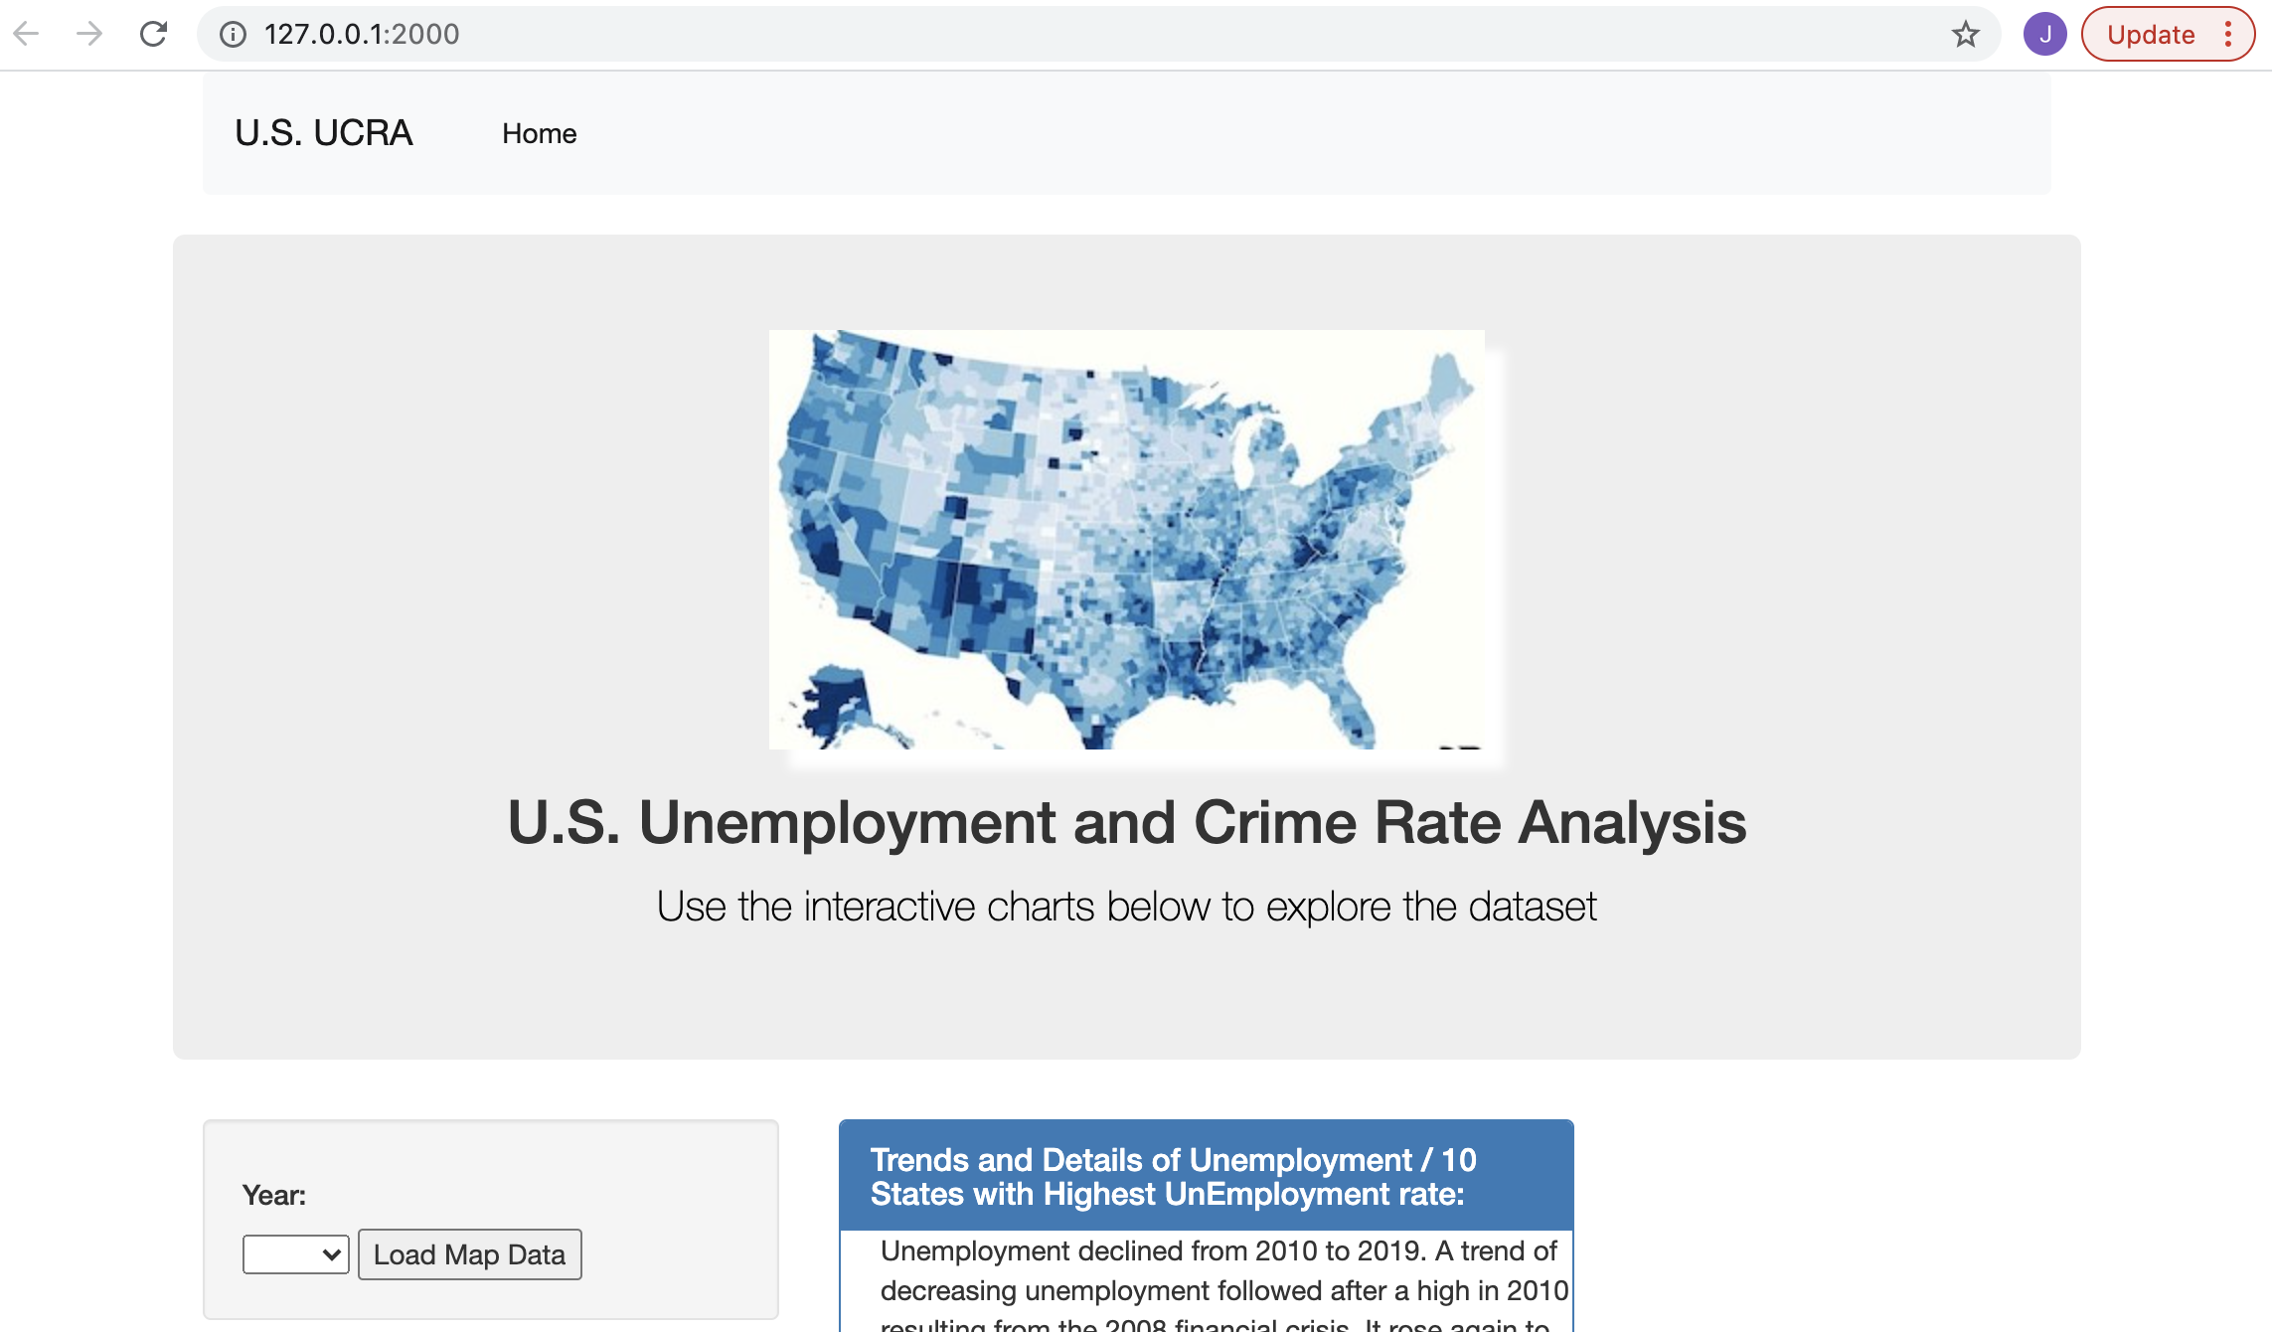
User interface

Slide 11
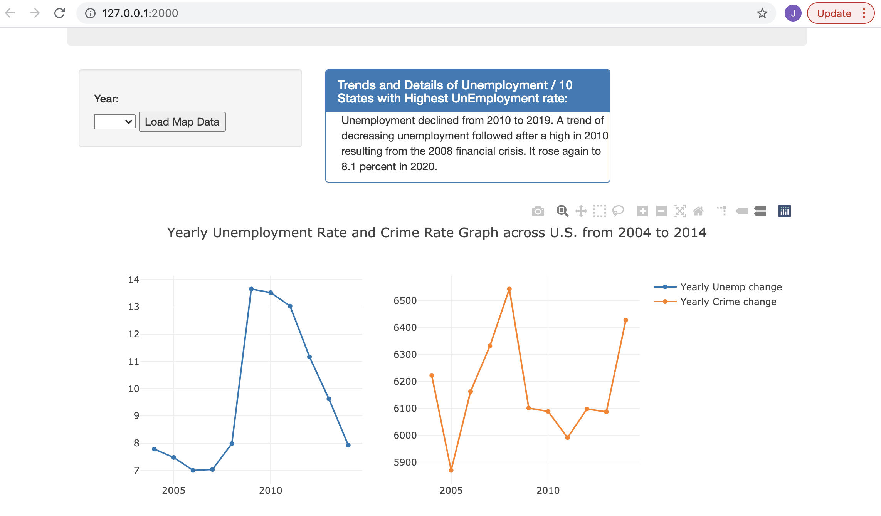
User interface

Slide 12
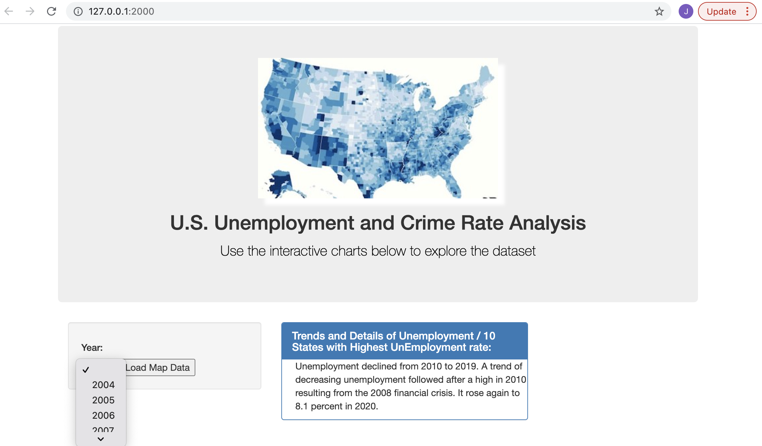
Dashboard Settings
User is capable to select the year of interest to evaluate both factor (i.e. Unemployment and Crime)
The user is also able to visualize a map which displays the profile of each state

Slide 13
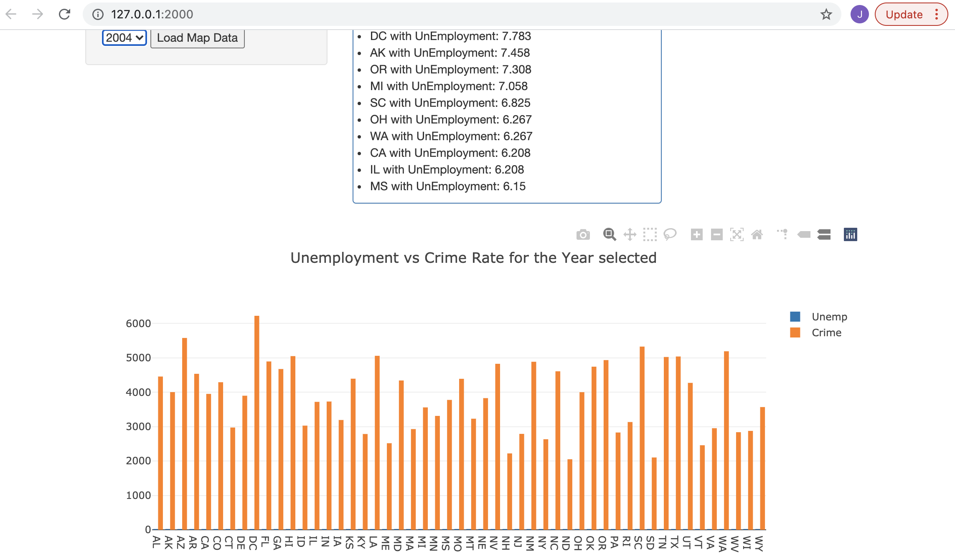
Dashboard Settings
Based on the year selected by the user, data will be visualized as a bar chart showing the unemployment rate or crime rate of each state in the selected year. User can select between unemployment and crime rate to display the bar chart .

Slide 14
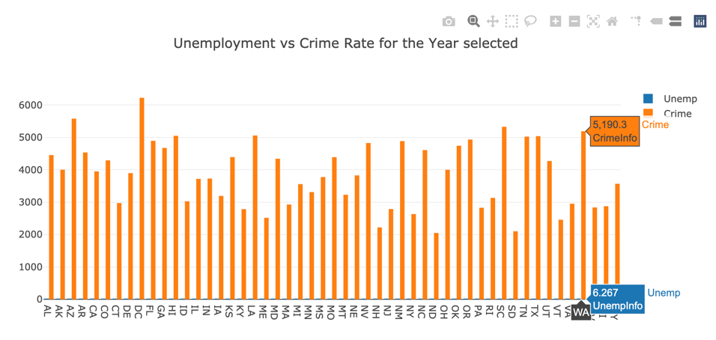
Unemployment and Crime Rates for the year selected:

Slide 15
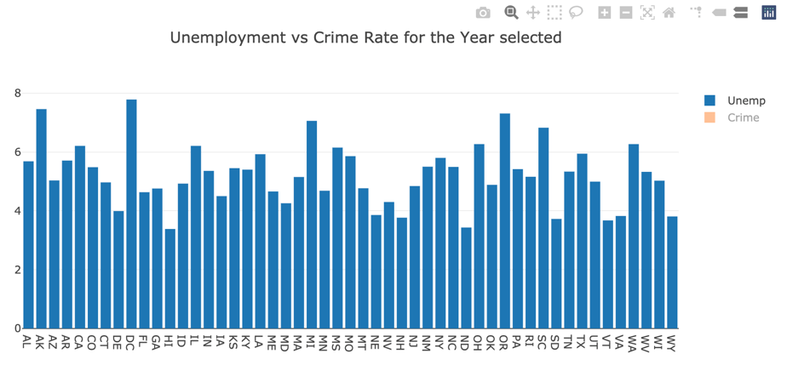
Additional views on the dashboard

Slide 16
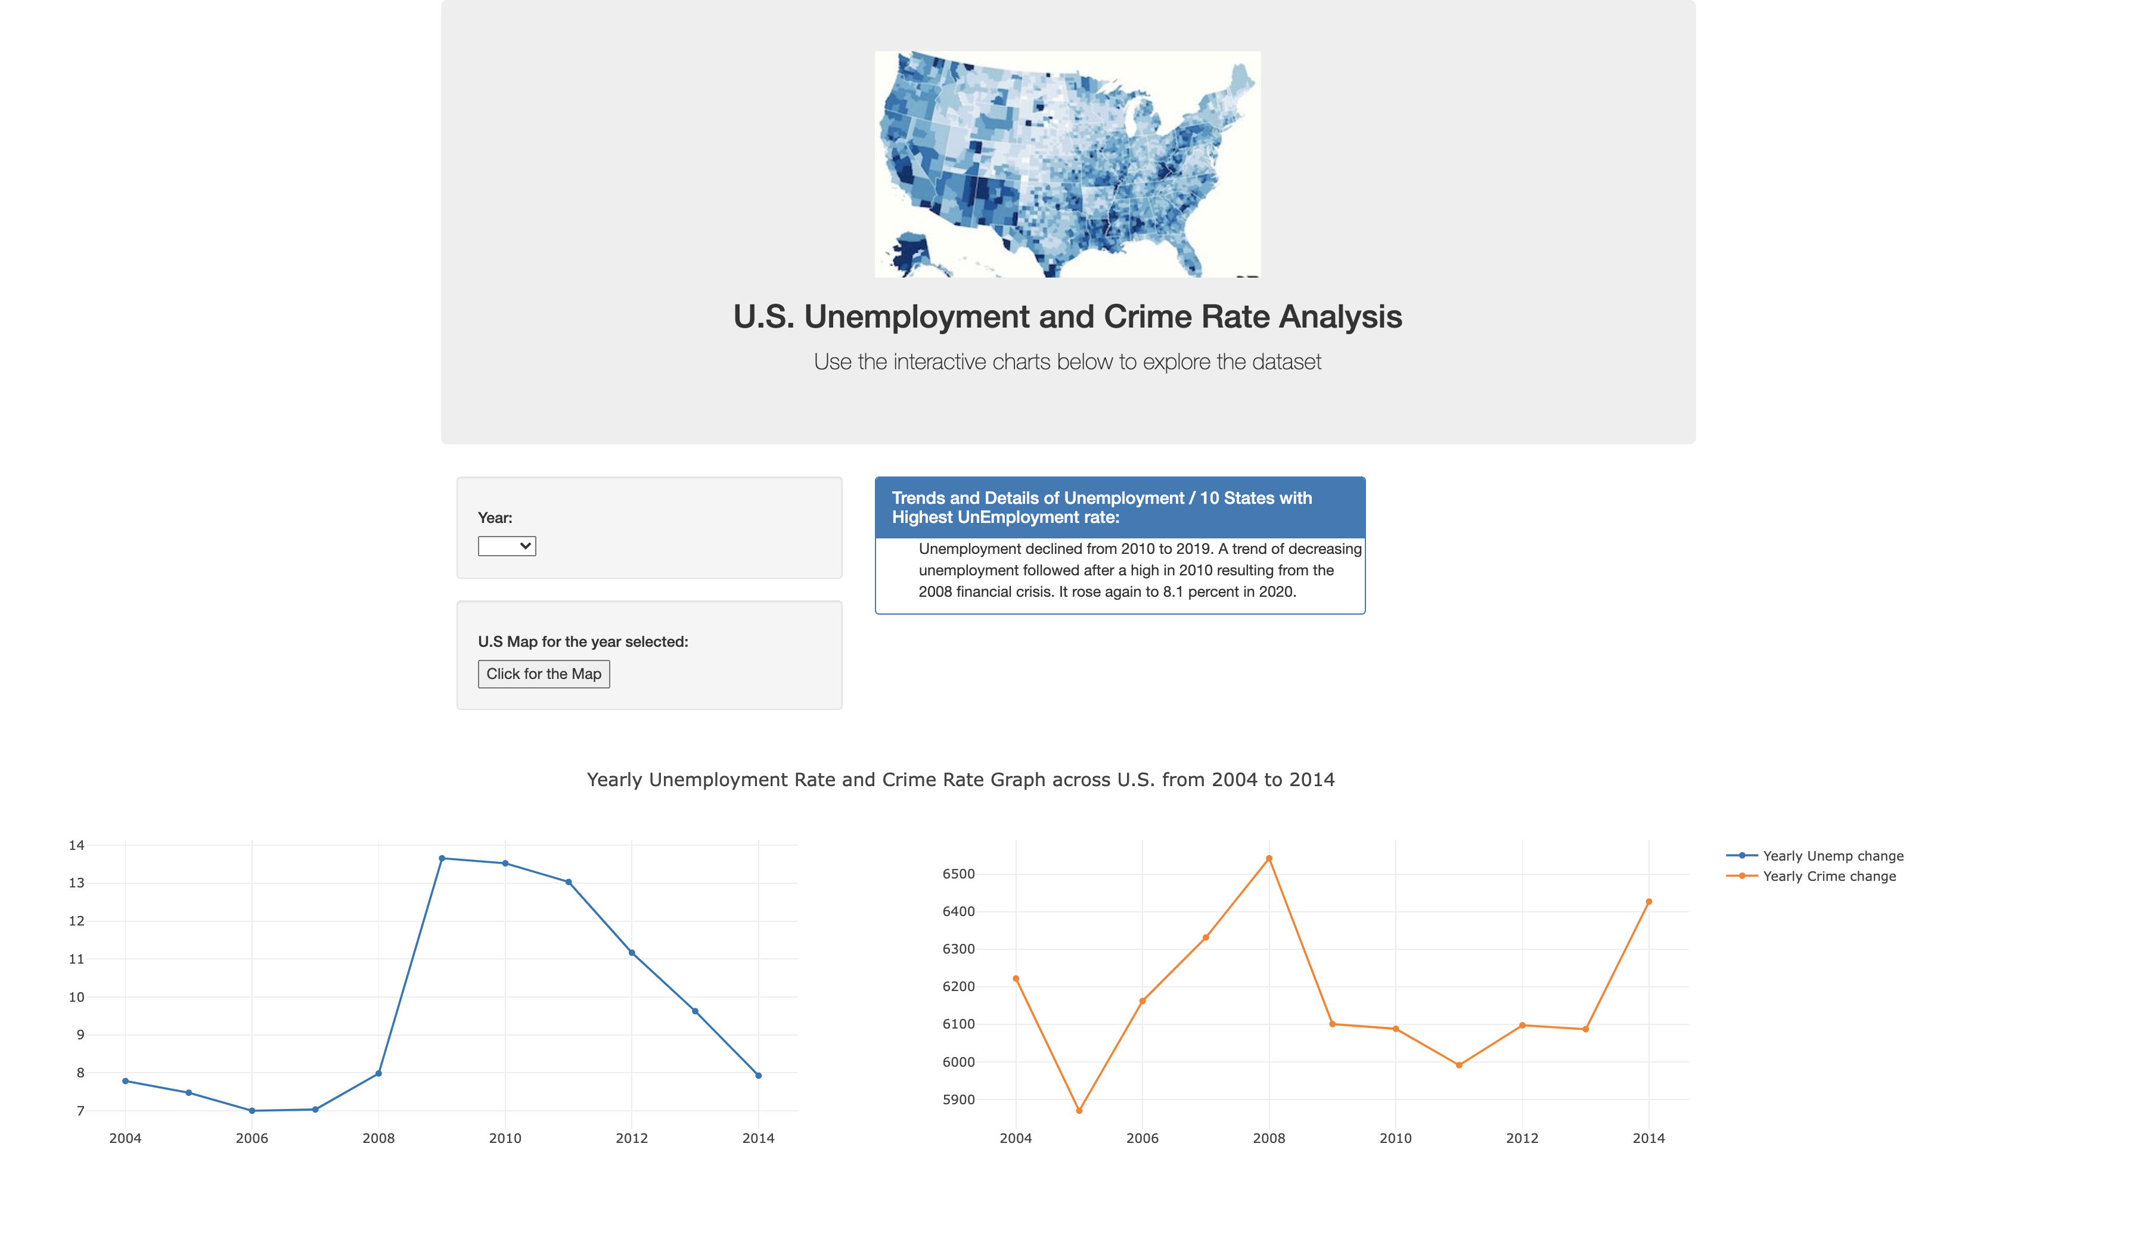
Digging deeper…
The dashboard has capabilities to show the user a detailed trend of the unemployment rate across the US
The timeframe set up to display ranges from 2004 to 2014.

Slide 17
Digging deeper…
Additionally, the dashboard has capabilities to show the user a detailed trend of the crime rate across the US from 2004 to 2014.
The information includes violent crimes and non-violent crimes.

Slide 18
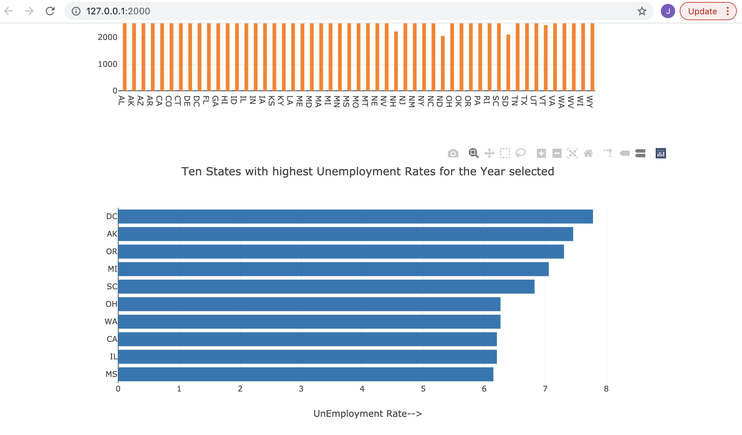
10 U.S. States with highest Unemployment rates for the selected year:

Slide 19
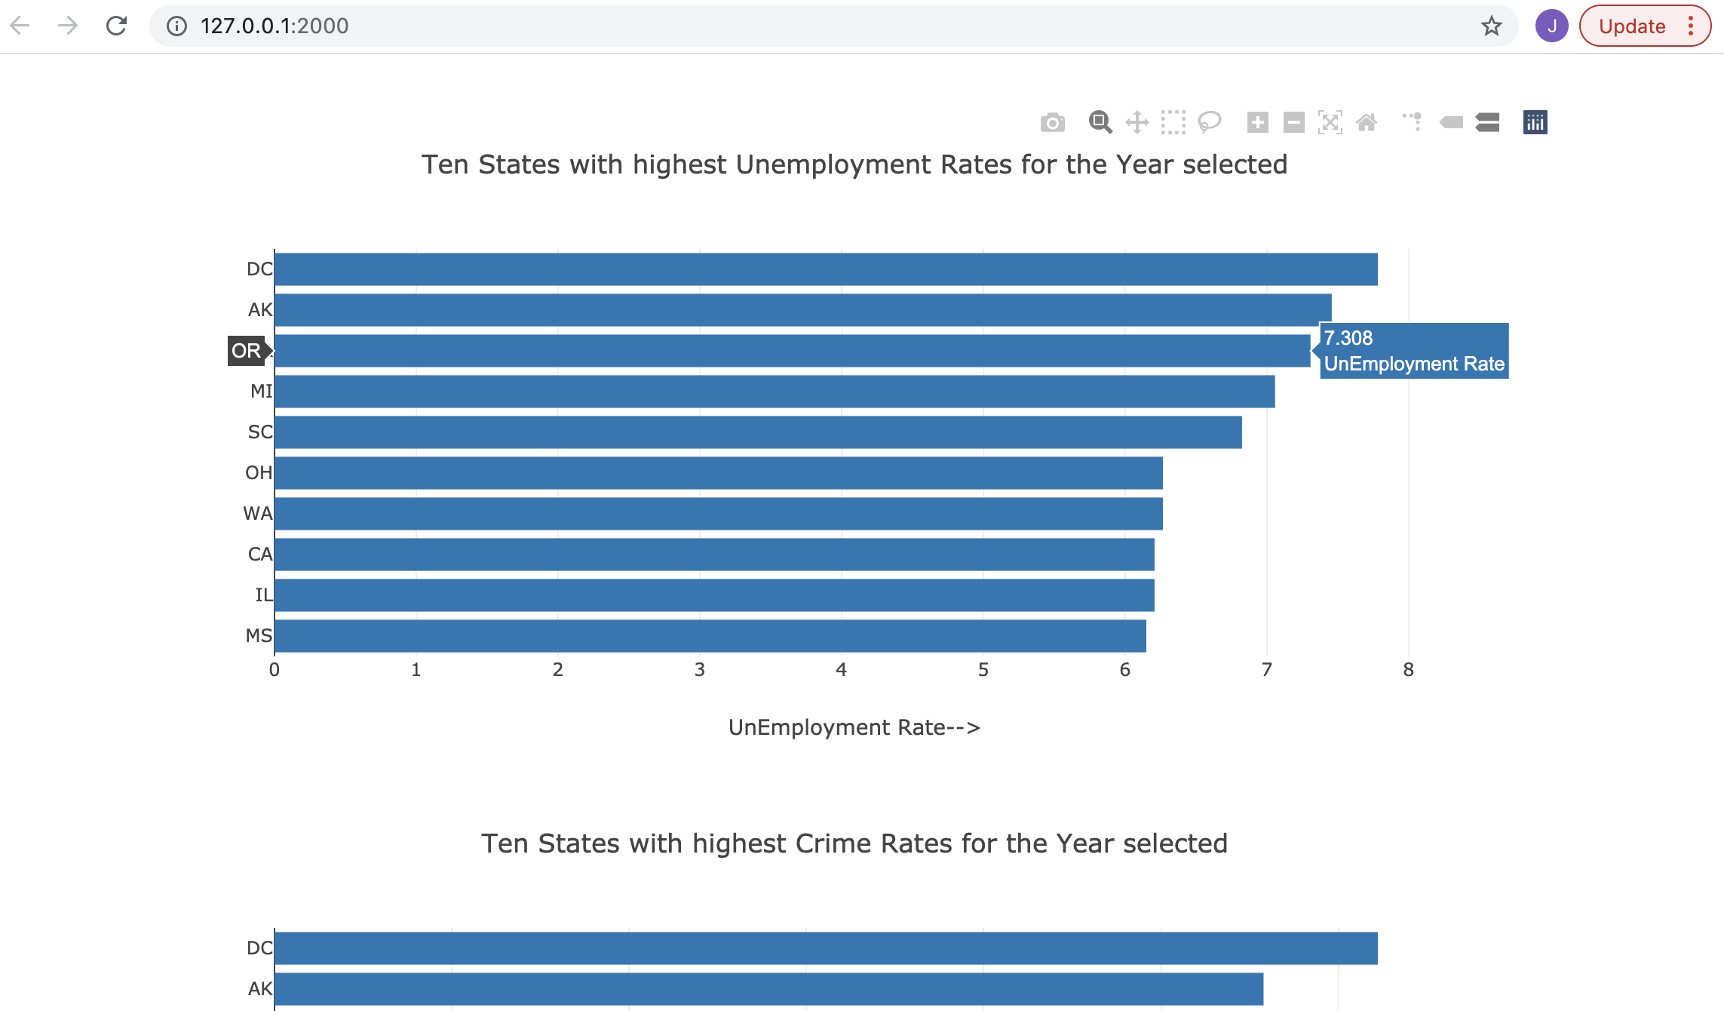

Slide 20
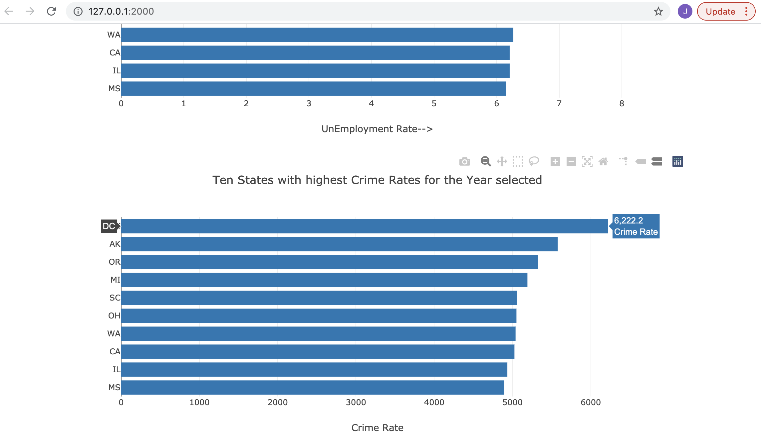
10 U.S. States with highest Crime rates for the selected year:

Slide 21
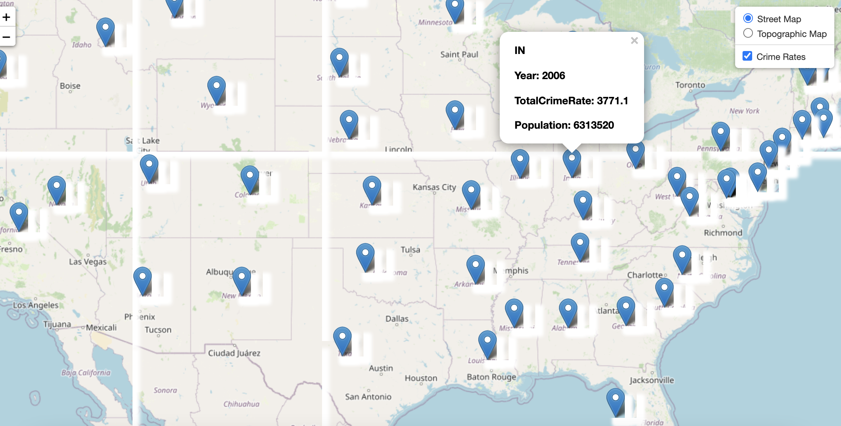
Leaflet map for the year selected:

Slide 22
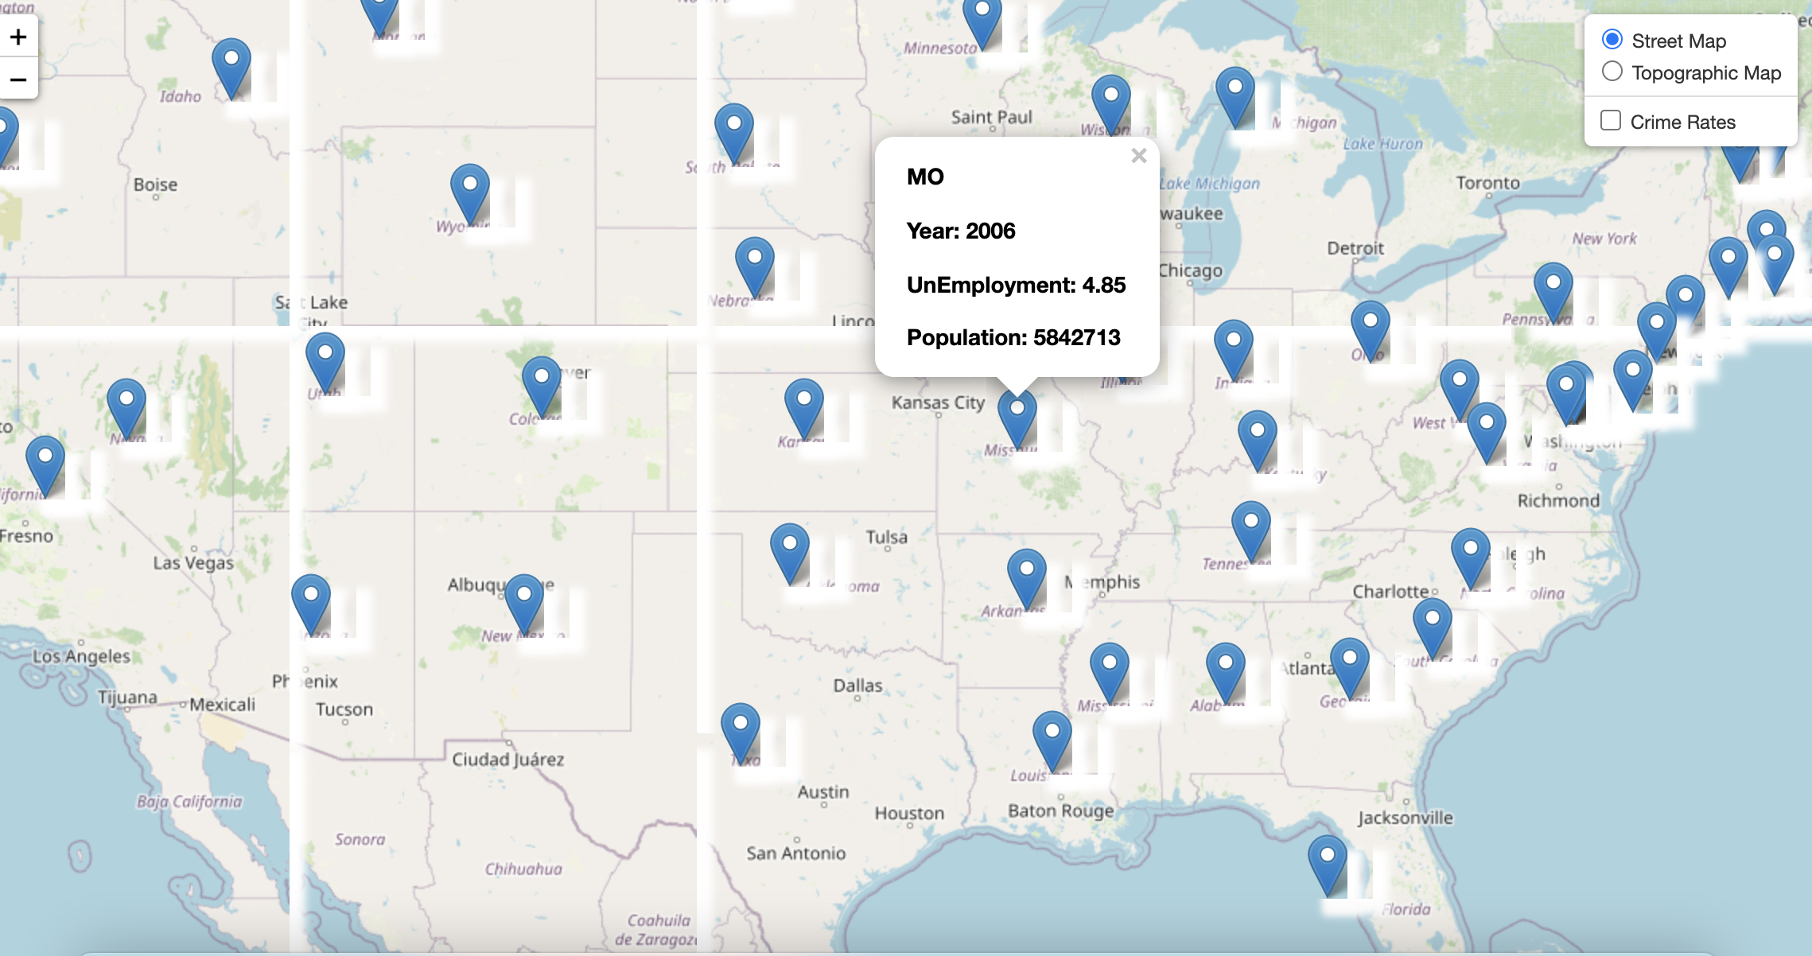

Slide 23

Conclusion
With this project we were able to see the importance of visualization of the data with an accurate and digestible way, can help the user to take better decisions by being well informed.

Slide 24


Q&A
Q&A

Slide 25
Georgia Tech | Analytics Boot camp
Thank You
Team: 01 - 800 NEED CASH NOW | Project 3

